Slide 1

Neural Substrates of Attention and Awareness
Dan Birman
Gardner Lab
Frisem – 2015-04-17

Slide 4
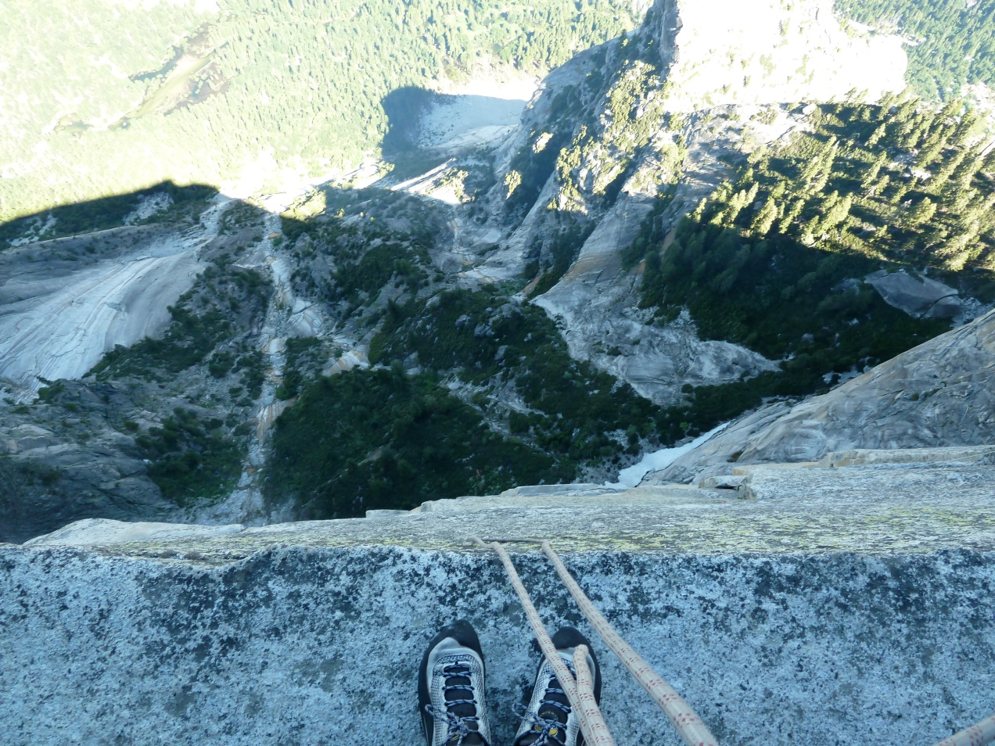

Slide 5
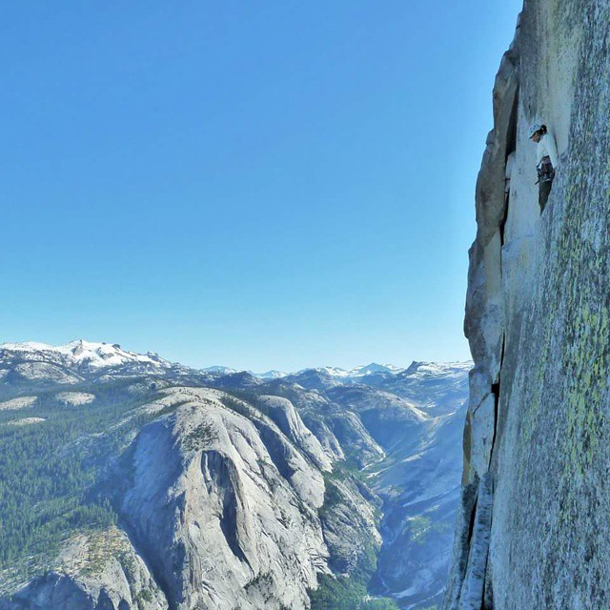

Slide 7







Slide 8
Neural Substrates of Attention and Awareness
Dan Birman
Gardner Lab
Frisem – 2015-04-17

Slide 11


Slide 12


Slide 13
Attention as a Pre-Requisite to Awareness
Dual task designs “pull” attention to one task, causing inattentional blindness for other stimuli.
“we believe […] there is no conscious perception without attention” (Mack & Rock, 1998)

Slide 14
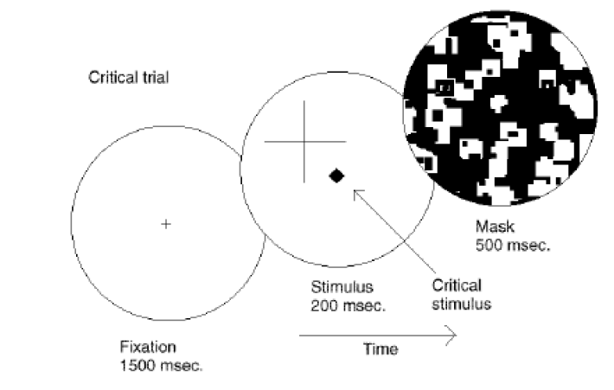
Attention as a Pre-Requisite to Awareness
Dual task designs “pull” attention to one task, causing inattentional blindness for other stimuli.
“we believe […] there is no conscious perception without attention” (Mack & Rock, 1998)
Mack & Rock, 1998
Notes:
There is one situation where attention (seems) to not be a pre-requisite for awareness

Slide 15
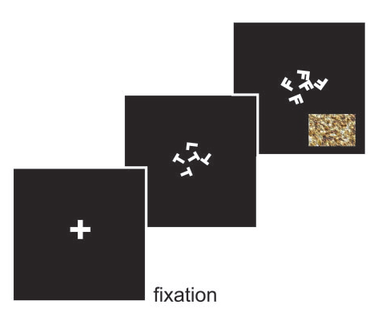
Gist Perception
“The close relationship between attention and
consciousness has led many scholars to conflate these processes“ (Koch & Tsuchiya, 2006)
Li et al., 2002

Slide 16
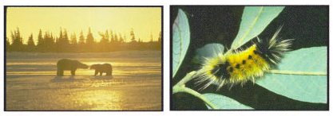
Gist Perception
“The close relationship between attention and
consciousness has led many scholars to conflate these processes“ (Koch & Tsuchiya, 2006)
Li et al., 2002

Slide 17
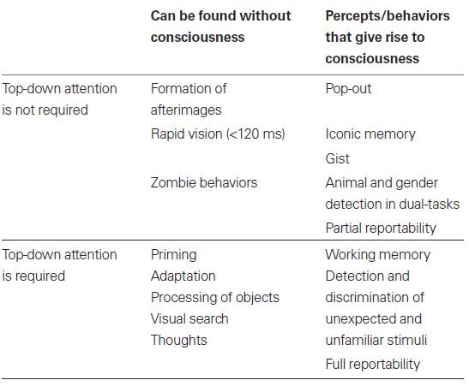
Van Boxtel et al. 2010.

Slide 18
Attention and Awareness as Mechanism
Attention, in the form of sensory enhancement, acts at the level of stimulus features, spatial features, and
We need models that can help us understand the mechanism of attention and awareness.

Slide 19
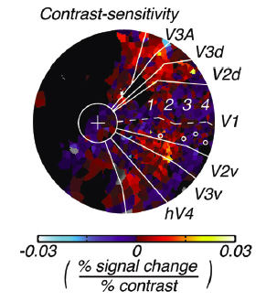
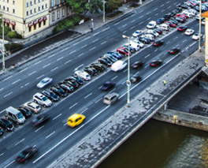
Conceptual Overview: Task Design
Where are the representations for different properties of stimuli held in the brain?
What are the neural effects of pushing attention to a specific location or feature?
How can we measure awareness while manipulating attention?
Notes:
First attempt: dual

Slide 20
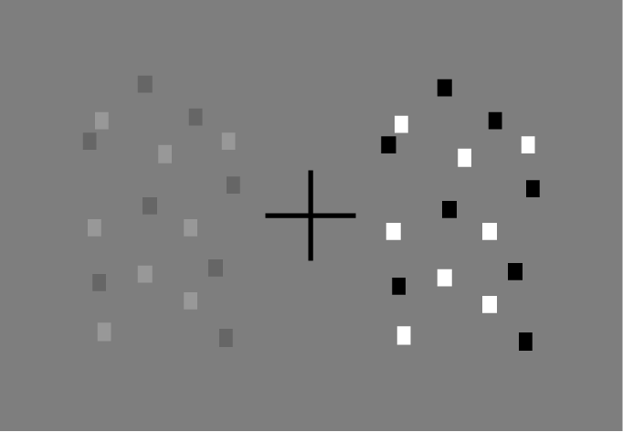
Task Design

Slide 21
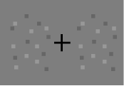
Task Design
Able to Discriminate (Aware)
Unable to Discriminate (Un-Aware)
A difference does exist—despite
a lack of awareness

Slide 22
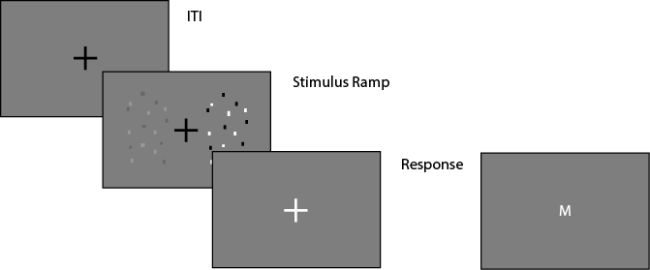
Task Design

Slide 23
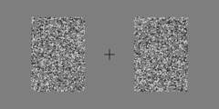
Task Design

Slide 24
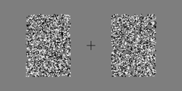
Task Design

Slide 25


Task Design
Cued: Contrast
Catch: Coherence
Cued: Coherence
Catch: Contrast

Slide 26
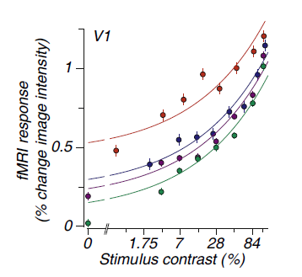
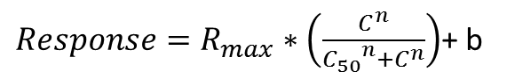
Neural Substrate of Attention
BOLD Magnitude
Attended
$Response=R_{max}∗\left(\frac{C^{n}}{{C_{50}}^{n}+C^{n}}\right)$+ b
Pestilli et al., 2011

Slide 27
Neural Substrate of Attention
BOLD Magnitude
Attended
$Response=R_{max}∗\left(\frac{C^{n}}{{C_{50}}^{n}+C^{n}}\right)$+ b
Unattended
Pestilli et al., 2011

Slide 28
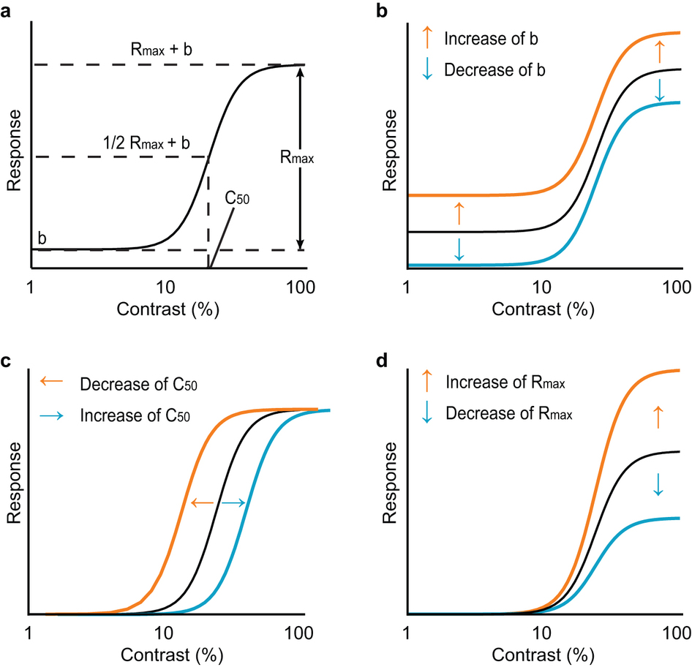
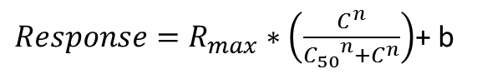
$Response=R_{max}∗\left(\frac{C^{n}}{{C_{50}}^{n}+C^{n}}\right)$+ b
Baseline Control
Contrast
Gain
Response Gain
Soma et al. 2013

Slide 30
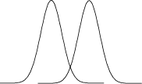

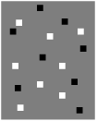
Neural Substrate of Attention
Bold Response Magnitude
Attended
Unattended

Slide 31
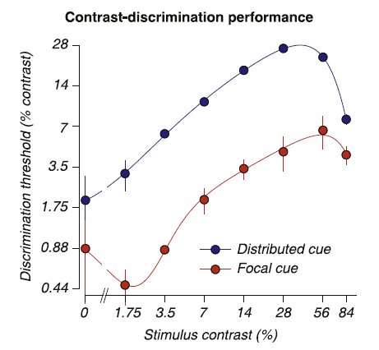
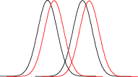
Neural Substrate of Attention
Attended
Unattended
Pestilli et al., 2011

Slide 32
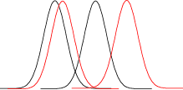
Neural Substrate of Attention
Attended
Unattended

Slide 33
Neural Substrate of Attention
Attended
Unattended

Slide 34
Behavioral Performance ←→ BOLD Magnitude
Attended
Unattended
Pestilli et al., 2011

Slide 35
Neural Substrate of Awareness
Attended
Unattended
7%
14%

Slide 36
Neural Substrate of Awareness
Psychophysical Threshold: ~80% Performance
Attended
Unattended
7%
14%

Slide 37
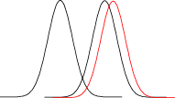
Neural Substrate of Awareness
Attended
Unattended
7%
14%

Slide 38
Neural Substrate of Awareness
Attended
Unattended
7%
14%
Pestilli et al., 2011

Slide 39
Neural Substrate of Awareness
Attended
Unattended

Slide 40
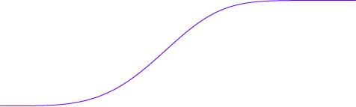
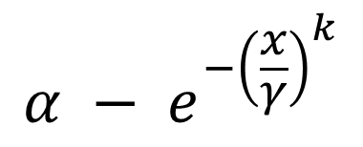
Neural Substrate of Awareness
$$α − e^{−{\left(\frac{x}{γ}\right)}^{k}}$$
Attended
100%
Unattended
Performance (%)
50%
.44 .88 1.75 3.5 7 14 28
Threshold Size

Slide 41
Neural Substrate of Awareness
Attended
100%
~80% Performance
Unattended
Performance (%)
50%
.44 .88 1.75 3.5 7 14 28
Threshold Size

Slide 42
Neural Substrate of Awareness
Attended
100%
~80% Performance
Unattended
Performance (%)
3.5% Contrast
Threshold
50%
.44 .88 1.75 3.5 7 14 28
Threshold Size

Slide 43
Neural Substrate of Awareness
Unaware:
No Discrimination
Aware:
Can Discriminate
Attended
100%
Unattended
Performance (%)
50%
.44 .88 1.75 3.5 7 14 28
Threshold Size

Slide 44
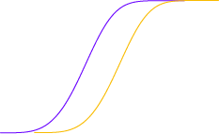
Neural Substrate of Awareness
Unaware:
No Discrimination
Aware:
Can Discriminate
Attended
100%
Unattended
Performance (%)
50%
.44 .88 1.75 3.5 7 14 28
Threshold Size

Slide 45
Neural Substrate of Awareness
Unaware:
No Discrimination
Aware:
Can Discriminate
Attended
100%
Unattended
Performance (%)
50%
.44 .88 1.75 3.5 7 14 28
Threshold Size

Slide 46
Neural Substrate of Awareness
Attended
100%
Unattended
Performance (%)
50%
.44 .88 1.75 3.5 7 14 28
Threshold Size

Slide 47
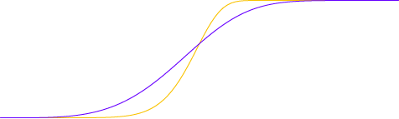
Neural Substrate of Awareness
Attended
100%
Unattended
Performance (%)
50%
.44 .88 1.75 3.5 7 14 28
Threshold Size

Slide 48
Neural Substrate of Awareness

Slide 49
Neural Substrate of Awareness

Slide 50
Neural Substrate of Awareness

Slide 51
Neural Substrate of Awareness
Outside
Inside Scanner

Slide 52
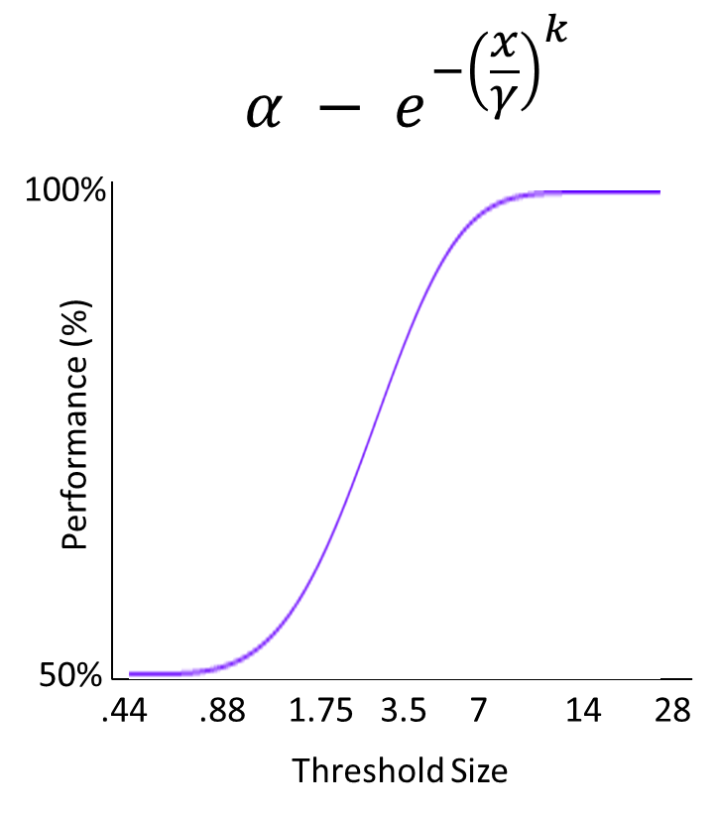
Conceptual Overview: Attention & Awareness
If attention and awareness are dissociable, we might expect to see dissociated neural correlates.
BOLD Response
Modulated by Attention
Discrimination
Performance
Notes:
First attempt: dual

Slide 53
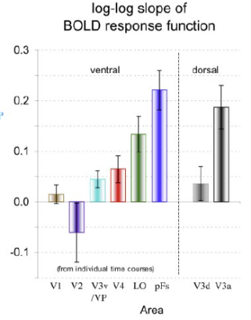
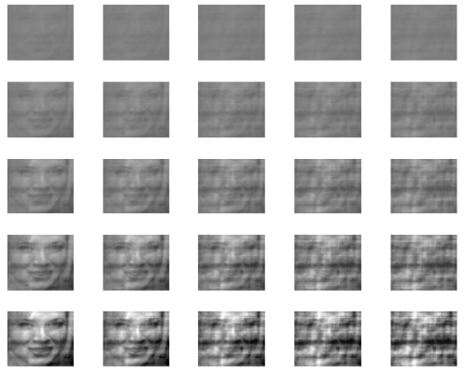
Conceptual Overview: Task Design
Where are the representations for different properties of stimuli held in the brain?
What are the neural effects of pushing attention to a specific location or feature?
Notes:
First attempt: dual

Slide 54
Conceptual Overview: Task Design
Where are the representations for different properties of stimuli held in the brain?
What are the neural effects of pushing attention to a specific location or feature?
How can we measure awareness while manipulating attention?
Notes:
First attempt: dual

